Slide 1
Verification and Validation
Anika Tabassum
Lecturer
CSE, EWU

Slide 2
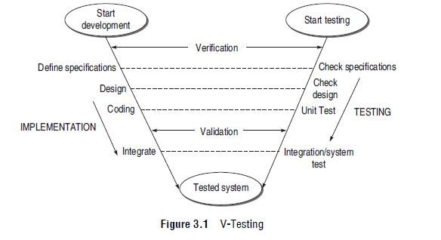
V-Testing

Slide 3
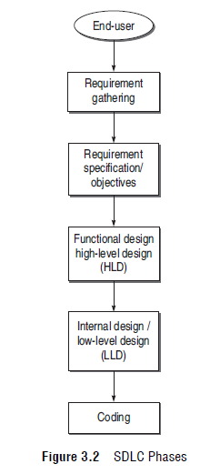
VERIFICATION AND VALIDATION (V&V) ACTIVITIES

Slide 4
VERIFICATION
Verification is needed for the following:
If verification is not performed at early stages, there are always a chance of mismatch between the required product and the delivered product.
Verification exposes more errors.
Early verification decreases the cost of fixing bugs.
Early verification enhances the quality of software.

Slide 5
The goals of verification
Everything Must be Verified: In principle, all the SDLC phases and all the products of these processes must be verified.
Results of Verification May Not be Binary: Verification may not just be the acceptance or rejection of a product. For example, sometimes correctness of a requirement cannot be rejected or accepted outright, but can be accepted with a degree of satisfaction or rejected with a certain degree of modification.
Even Implicit Qualities Must be Verified: The qualities desired in the software are explicitly stated in the SRS. But those requirements which are implicit and not mentioned anywhere must also be verified.

Slide 6
VERIFICATION ACTIVITIES
Verification of Requirements and Objectives
Verification of High-Level Design
Verification of Low-Level Design
Verification of Coding (Unit Verification)

Slide 7
How every requirement in SRS should be verified?
Correctness:
(a) Testers should refer to other documentations or applicable standards and compare the specified requirement with them.
(b) Testers can interact with customers or users, if requirements are not well-understood.
(c) Testers should check the correctness in the sense of realistic requirement. If the tester feels that a requirement cannot be realized using existing hardware and software technology, it means that it is unrealistic. In that case, the requirement should either be updated or removed from SRS.

Slide 8
How every requirement in SRS should be verified?
Unambiguous:
(a) Every requirement has only one interpretation.
(b) Each characteristic of the fi nal product is described using a single unique term.

Slide 9
How every requirement in SRS should be verified?
Consistent:
(a) Real-world objects confl ict, for example, one specification recommends mouse for input, another recommends joystick.
(b) Logical conflict between two specified actions, e.g. one specification requires the function to perform square root, while another specification requires the same function to perform square operation.
(c) Conflicts in terminology should also be verified. For example, at oneplace, the term process is used while at another place, it has been termed as task or module.

Slide 10
How every requirement in SRS should be verified?
Completeness:
(a) Verify that all signifi cant requirements such as functionality, performance, design constraints, attribute, or external interfaces are complete.
(b) Check whether responses of every possible input (valid & invalid) to the software have been defi ned.
(c) Check whether fi gures and tables have been labeled and referenced completely.

Slide 11
How every requirement in SRS should be verified?
Updation:
(a) If the specification is a new one, then all the above mentioned steps and their feasibility should be verified.
(b) If the specification is a change in an already mentioned specification, then we must verify that this change can be implemented in the current design.

Slide 12
How every requirement in SRS should be verified?
Traceability:
Backward traceability Check that each requirement references its source in previous documents.
Forward traceability Check that each requirement has a unique name or reference number in all the documents. Forward traceability assumes more meaning than this, but for the sake of clarity, here it should be understood in the sense that every requirement has been recognized in other documents.

Slide 13
HOW TO VERIFY HIGH-LEVEL DESIGN?
Data Design
Architectural Design
Interface Design

Slide 14
HOW TO VERIFY LOW-LEVEL DESIGN?
􀂄 Verify the SRS of each module.
􀂄 Verify the SDD of each module.
􀂄 In LLD, data structures, interfaces, and algorithms are represented by design notations; verify the consistency of every item with their design notations.

Slide 15
HOW TO VERIFY CODE?
􀂄 Check that every design specification in HLD and LLD has been coded using traceability matrix.
􀂄 Examine the code against a language specification checklist.
􀂄 Code verification can be done most efficiently by the developer, as he has prepared the code. He can verify every statement, control structure, loop, and logic such that every possible method of execution is tested.

Slide 16
HOW TO VERIFY CODE?
Two kinds of techniques are used to verify the coding:
(a) static testing, and (b) dynamic testing.
Static testing techniques This technique does not involve actual execution. It considers only static analysis of the code or some form of conceptual execution of the code.
Dynamic testing techniques It is complementary to the static testing technique. It executes the code on some test data. The developer is the key person in this process who can verify the code of his module by using the dynamic testing technique.

Slide 17
VALIDATION
What is the need for validation?
􀂄 To determine whether the product satisfies the users’ requirements, as stated in the requirement specification.
􀂄 To determine whether the product’s actual behaviour matches the desired behaviour, as described in the functional design specification.
􀂄 It is not always certain that all the stages till coding are bug-free. The bugs that are still present in the software after the coding phase need to be uncovered.
􀂄 Validation testing provides the last chance to discover bugs, otherwise these bugs will move to the final product released to the customer.
􀂄 Validation enhances the quality of software.

Slide 18
VALIDATION ACTIVITIES
Validation Test Plan:
Acceptance test plan
System test plan
Function test plan
Integration test plan
Unit test plan
Validation Test Execution
Unit validation testing
Integration testing
Function testing
System testing
Acceptance testing
Installation testing

